Slide 1


Right to Defense, Due Process, and Dejudicialization of Dispute Resolution
Vitoria,4 April 2025
Elena D’Alessandro
University of Turin

Slide 2


Presentation Outline
01
Introduction/Historical Background
By examining the past, we can better grasp the complexities of today’s legal landscape and the ongoing debates concerning the shift from courts.
03
Out-of-court
Enforcement
Open issues
02
Dejudiciatization of Dispute Resolution
Risks to manage/mitigate

Slide 3
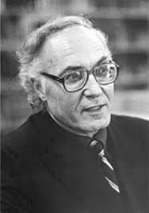

Historical Background
Until the first half of the 19th century, civil procedure in Europe was regarded as a matter solely concerning the parties involved ( “Sache der Parteien”).
During this period, litigation was essentially a private matter.
This private nature of civil litigation also gave the parties considerable dominance over the conduct of the proceedings.

Slide 4
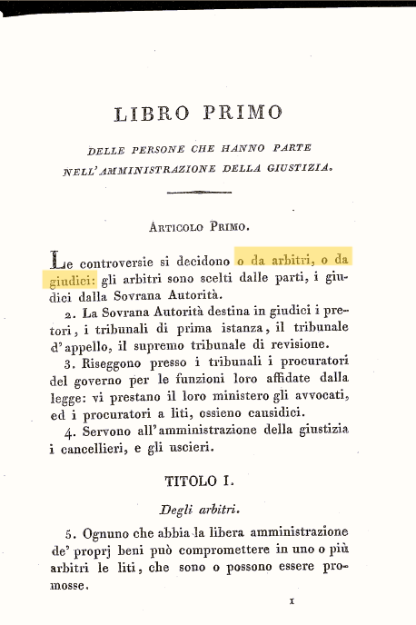

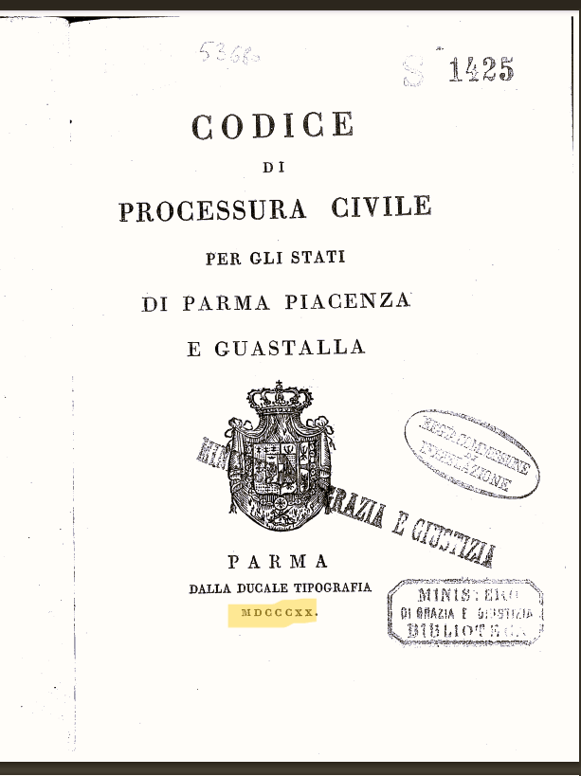
Italy as an Example
The pre-unification Italian codes and the Italian Code of Civil Procedure of 1865 reflected a society rooted in “laissez-faire principles”
Disputes are to be decided either by arbitrators or by judges, with arbitration taking precedence
Article 1 of the Code of Civil Procedure for the States of Parma and Guastalla of 1820.

Slide 5

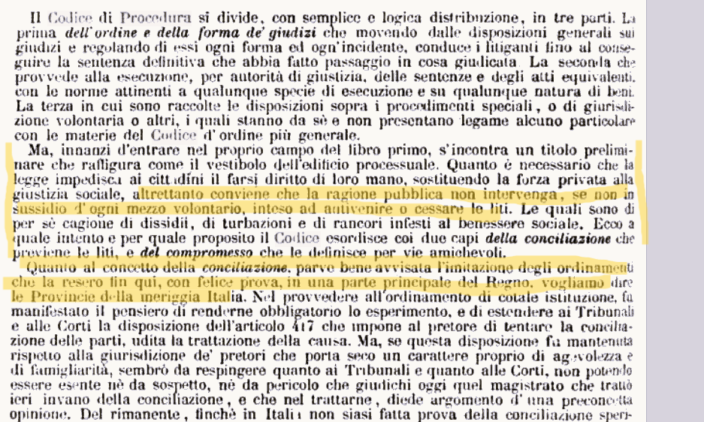
Italy as an Example
“It is preferable, for the State, to refrain from intervention, except to facilitate voluntary mechanisms for dispute resolution” (Explanatory Report Italian Code of Civil Procedure, 1865)

Slide 6
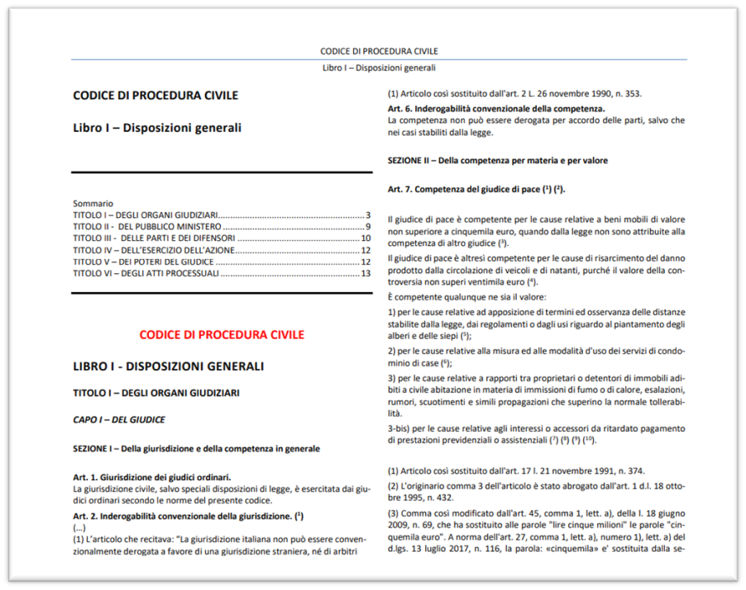
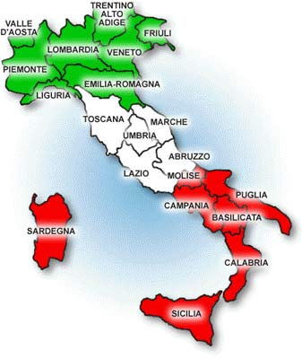
The «Public Approach» was also embraced by the Italian Legislator in 1942

Slide 7
The «Public Approach» was also embraced by the Italian Legislator in 1942
This change was influenced by Franz Klein. He saw civil disputes as infringements of the “common good” and the judicial process as a "welfare institution".
Civil Procedure became an instrument of distributive justice. The balance of power between the parties and the judge had to be reconfigured in a socially oriented system of civil procedure

Slide 8
Historical Background
In the 1970s, Mauro Cappelletti observed that there was a marked increase in interest in informal alternatives to the courts as traditional courts and lawyers came under increasing criticism for being too costly and slow to deal with the growing volume of legal disputes generated by the modern state. They were also increasingly seen as inadequate to deal with the evolving nature of contemporary conflict.
He foresaw a profound change in the field of civil justice, arguing that the complexity of contemporary societies required new and improved methods of dispute resolution, as traditional mechanisms were increasingly inadequate to address societal - and even civilisational - challenges.

Slide 9
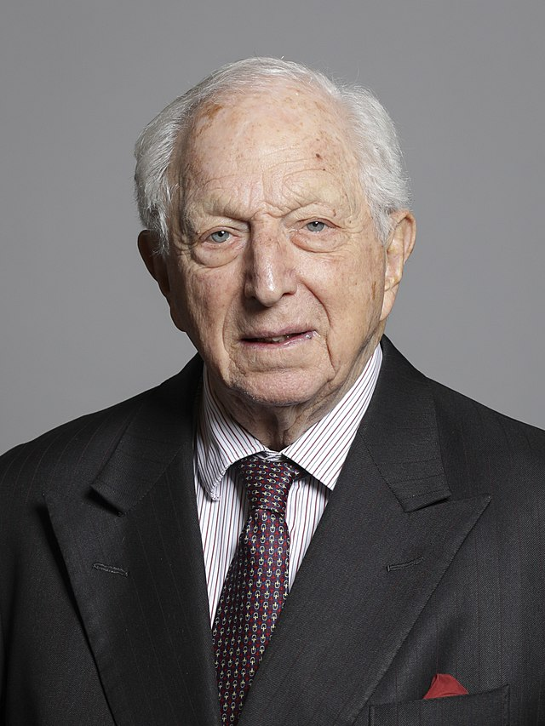
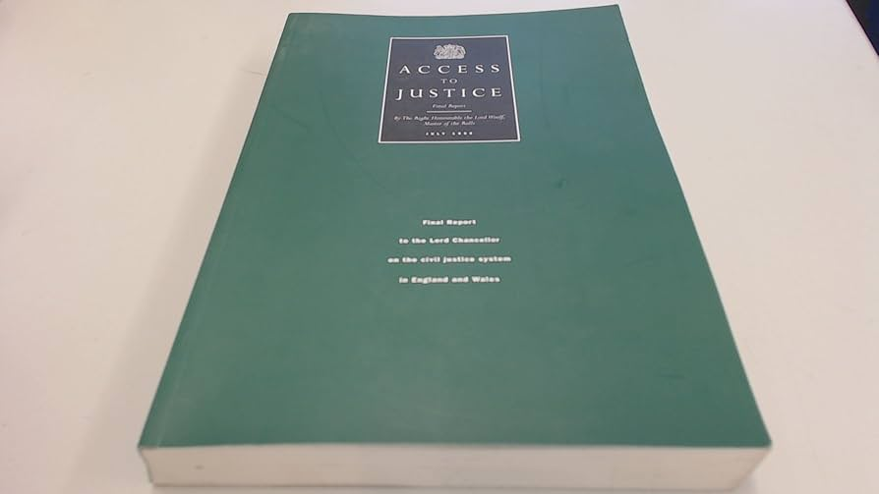
Historical Background
Excessive costs
Delays
Inequality
Uncertainty
Incomprehensibility: The system was overly complex and difficult for many litigants to understand.
Lord Jackson emphasised the benefits of alternative dispute resolution (ADR) and recommended a concerted effort to:
(a) Ensure that all litigation lawyers and judges are adequately informed about the advantages of ADR.
1997

Slide 10
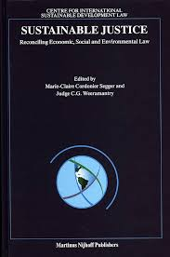
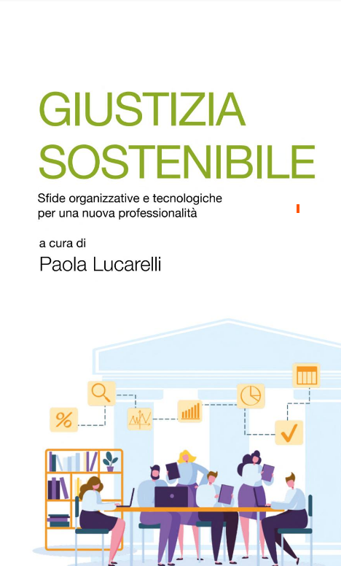

The current crisis in the European welfare
The current crisis in the European welfare state, which has led to reductions in public assistance, social security, public education, and free healthcare services, has also impacted the State’s role as a provider of public services, including civil justice.
Some academics in Italy now refer to the concept of "social sustainability" or "sustainable justice" .

Slide 11


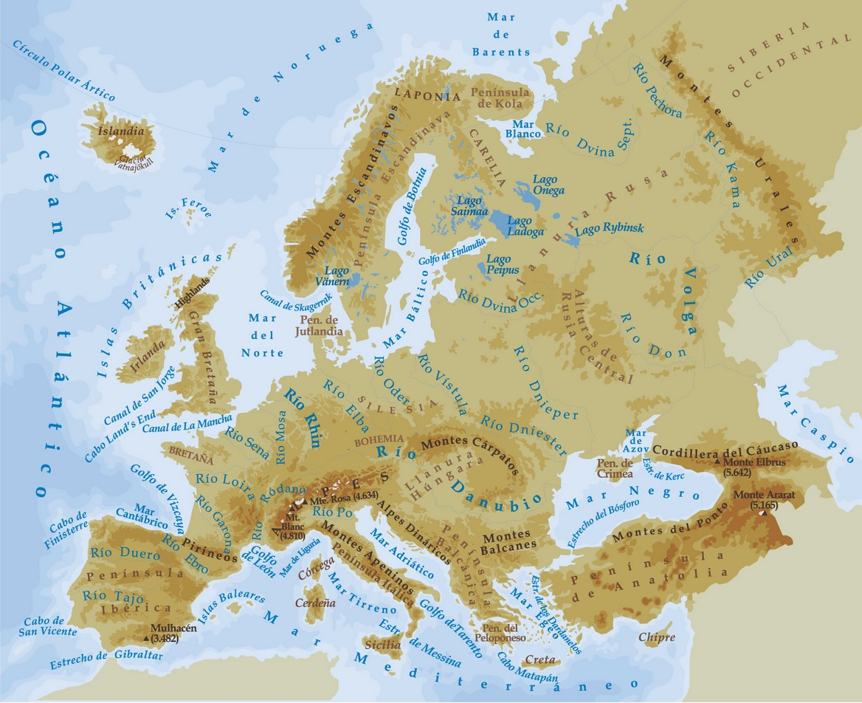
Current trend
This trend is reflected in the fact that, for the EU Justice Scoreboard, the capacity to access alternative dispute resolution (ADR) methods is regarded as a key indicator of the efficiency of a judicial system.

Slide 12
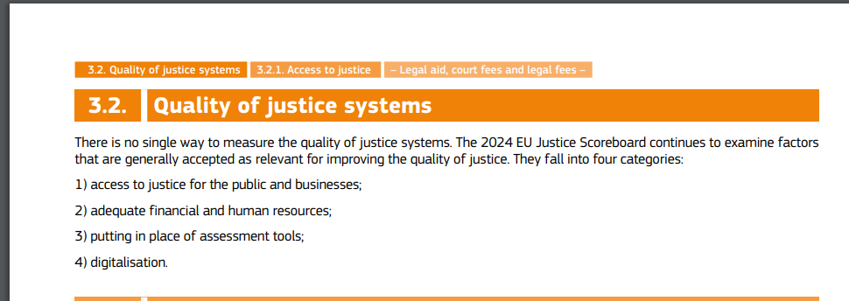
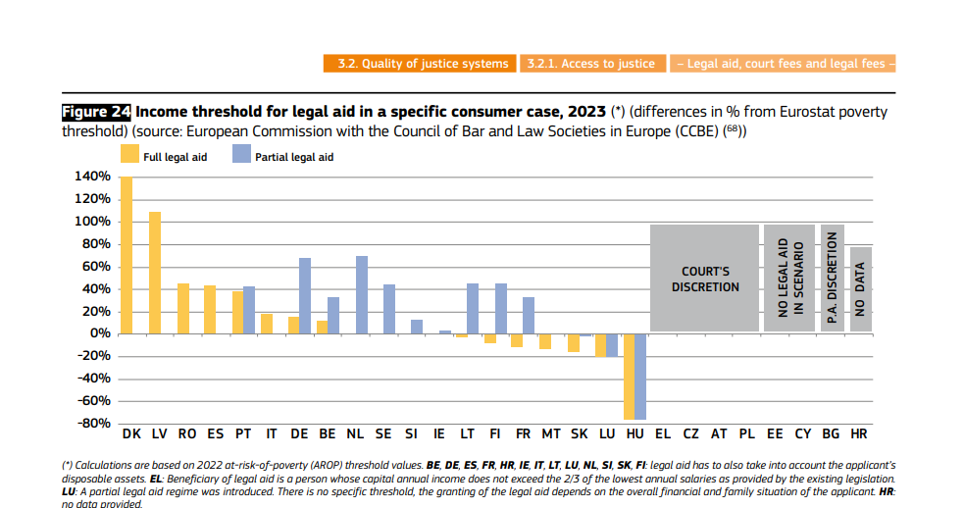
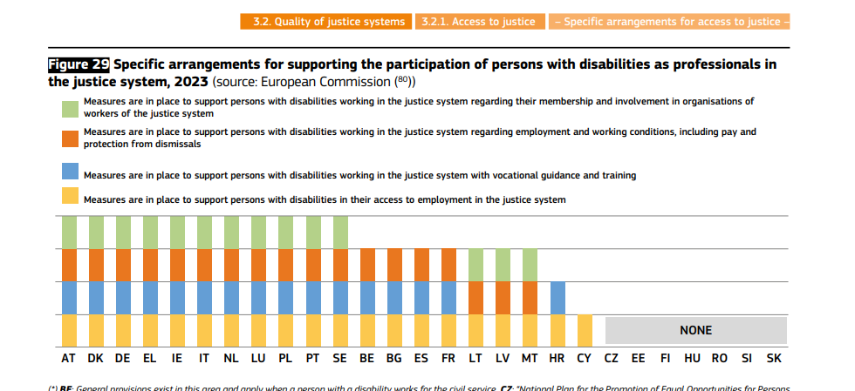
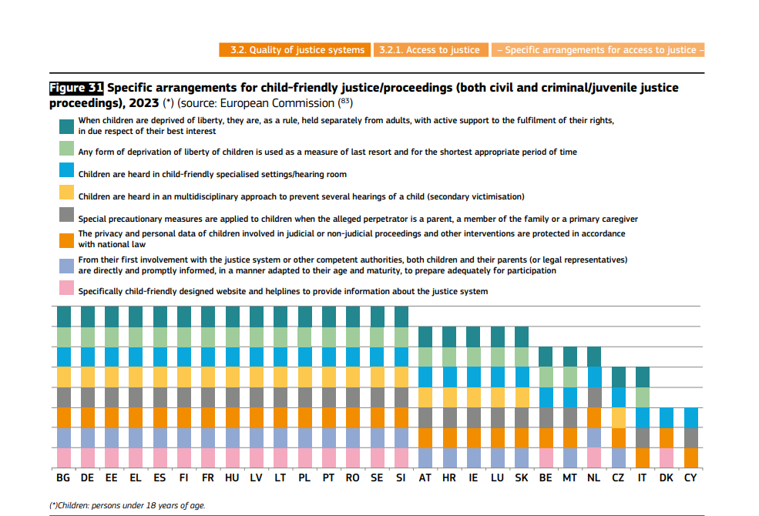
Current Trend

Slide 13
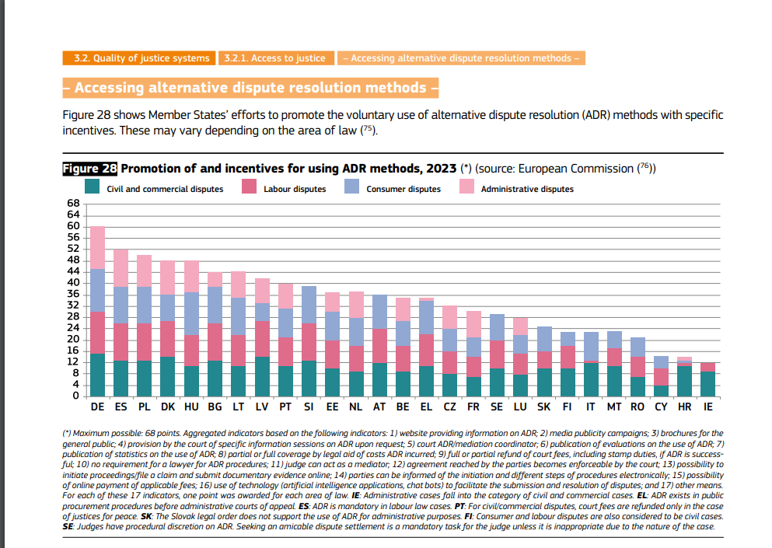
Current Trend

Slide 14
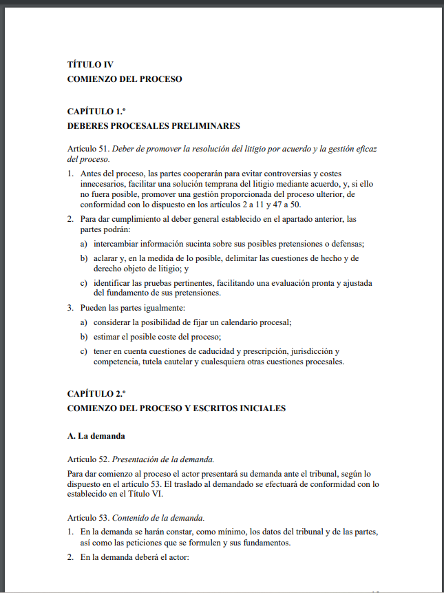
Current Trend
ELI Unidroit model rules on civil procedure commence with "Pre-commencement procedural duties”

Slide 15
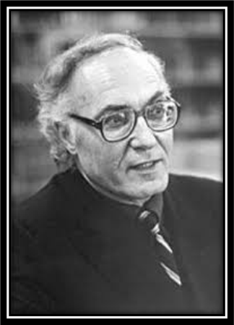
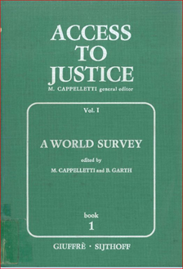
Current Trend
“Scholars must now recognize that procedural techniques serve social functions, that courts are not the only means of dispute resolution that must be considered, and that every procedural regulation, including the creation or encouragement of alternatives to the formal court system, has a pronounced effect on how the substantive law operates, how often it is enforced, in whose benefit, and with what social impact” (Cappelletti & Garth, Access to justice).

Slide 16


Risks to manage/mitigate
“A solution that is not imposed but negotiated is not necessarily the fairest, especially when the parties are in an unbalanced position. It is therefore essential to check that the solution is genuinely desired by both parties.
If this is not the case, in order to safeguard the rights of the defence, it is still possible to have recourse to the judicial authority in order to challenge the negotiated out-of-court settlement”

Slide 17
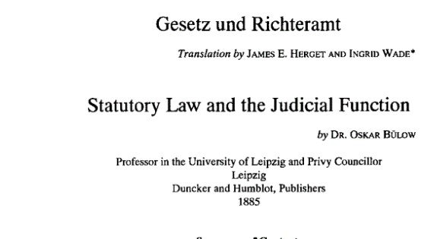
Risks to Manage/Mitigate
A shift away from the courts implies a reduction in the law-making function of the judiciary

Slide 18

Risks to manage
It is crucial to ensure that parties choosing out-of-court mechanisms do so not merely because these methods are cheaper and faster, but because they are the most appropriate means of resolving their specific dispute. Otherwise, there is a risk of undermining access to justice and the right to a fair defence.
When a court encourages the parties to pursue out-of-court mediation, its primary consideration should not be the need to reduce its own workload, but rather an assessment of whether the dispute is genuinely suitable for mediation. Furthermore, if the out-of-court mediation attempt proves unsuccessful, the court should not approach the case with any preconceived bias, assuming that a settlement would have been the preferable outcome.

Slide 19
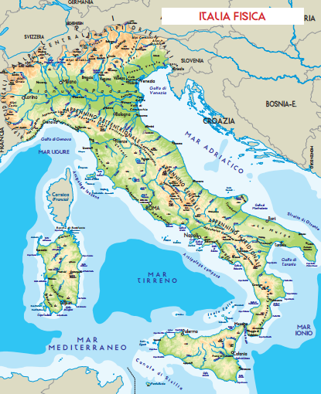



Dejudicialization in practice:
Risks to Mitigate
Example 1: out-of-court mediation
.
Principle of territorial proximity between the court and the defendant
Location of the Mediation body
Torino
Defendant’s domicile
Palermo

Slide 20
Dejudicialization in practice:
Risks to Mitigate
Example 1: out-of-court mediation
According to Article 4(1) of Legislative Decree No. 28/2010, mandatory mediation must be conducted before a mediation body located within the district of the court that has territorial jurisdiction over the dispute, even when the mediation proceedings are conducted digitally (Tribunal of Civitavecchia, 18 December 2024, No. 16380). This rule may only be derogated from by mutual agreement of the parties. The rationale behind this requirement is to align the competence of the mediation body with the rules of territorial jurisdiction, ensuring proximity to the respondent and thereby upholding one of the fundamental principles of due process.

Slide 21
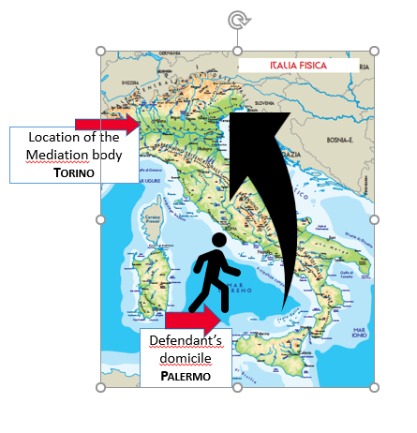
Dejudicialization in practice:
Risks to Mitigate
Italian case law has addressed the question of whether mediation initiated before a mediation body lacking territorial competence satisfies the statutory requirement for admissibility. The courts have held that failure to comply with the territorial jurisdiction requirements renders the mediation ineffective and does not fulfil the procedural condition necessary for the admissibility of the claim.
Principle of territorial proximity between the Mediation body and the defendant

Slide 22
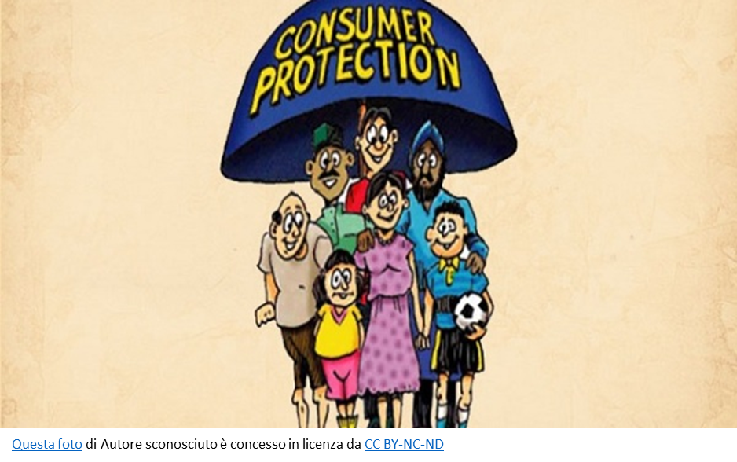

Dejudicialization in practice:
Risks to Mitigate
Example 2: Dejudicializazion and consumers
The European Directive 93/13/EEC of 5 April 1993 on unfair terms in consumer contracts as interpreted by the case law of the Court of Justice of the European Union (CJEU), requires judicial review of contract terms to ensure that none are unfair.
Dejudicialisation may impede the judicial review required by European legislation.

Slide 23


Dejudicialization in practice:
Risks to Mitigate
Example 2: Dejudicializazion and consumers
For example: when a payment order is issued by a judicial officer or electronically through an automated process without human intervention, the review must necessarily be conducted by a judge at a later stage. There are no exceptions to this requirement, as confirmed by the CJEU.
(Judgment of the Court (First Chamber) of 14 June 2012, Case C-618/10, Banco Español de Crédito; Judgment of 29 February 2024, Case C-724/22, Investcapital Ltd; Judgment of 8 February 2016, Case C-49/14, Finanmadrid).
Questa foto di Autore sconosciuto è concesso in licenza da CC BY-SA

Slide 24


Dejudicialization in practice:
Risks to Mitigate

Slide 25

A growing trend to extend dejudicialisation to cases involving vulnerable citizens
Example 3: French out- of-court consensual divorces and children right to be heard
French Law No. 2016-1547 of 18 November 2016 established out-of-court divorce as the sole procedure for consensual divorce.
The child's right to be heard is mediated by the parents, who are required to inform the child in a clear and accessible manner about their rights. However, the younger the child, the more difficult this becomes, particularly when the parents' interests conflict with those of the child.
There is no obligation for the child to have an impartial legal representative to protect their interests.

Slide 26

A growing trend to extend dejudicialisation to cases involving vulnerable citizens
Example 3: French out- of-court consensual divorces and children right to be heard
Specifically, Article 229-2 of the French Civil Code, states that “the minor, having been informed by their parents of their right to be heard by the court under the conditions set out in Article 388-1, may request a hearing with the judge” by signing a form”.
Can a mere form signed by the minor, under the guidance of their parents, truly be deemed sufficient?
Is the mutual agreement of the parents alone enough to ensure that the best interest of the child has been respected?

Slide 27


A growing trend to extend dejudicialisation to cases involving vulnerable citizens
Example 4: Vulnerable Adults
In many European countries— (Austria, Germany, France, and Spain) —there is a growing trend toward allowing private self-determination (out-of-court) in appointing a deputy guardian for vulnerable adults who are unable to manage their own affairs or express their wishes regarding medical treatment.
Judicial protection is only invoked when an individual has not exercised their self-determination through a contractual arrangement. In such residual cases, the judicial process takes on a public interest dimension, requiring the mandatory involvement of the public prosecutor (in France and Spain) or the possibility of official intervention by the authorities (in Austria and Germany).

Slide 28
A growing trend to extend dejudicialisation to cases involving vulnerable citizens
Example 5: Vulnerable Adults
Judicial protection serves as an after-the-fact safeguard: if the appointed representative fails to act in the best interests of the individual, any concerned party can initiate legal action.
However:
vulnerable individuals should receive support in drafting their contractual arrangements.
introduction of a supervisory role (as in France). Supervisors would be empowered to intervene by initiating legal proceedings or reporting irregularities to the public prosecutor

Slide 29
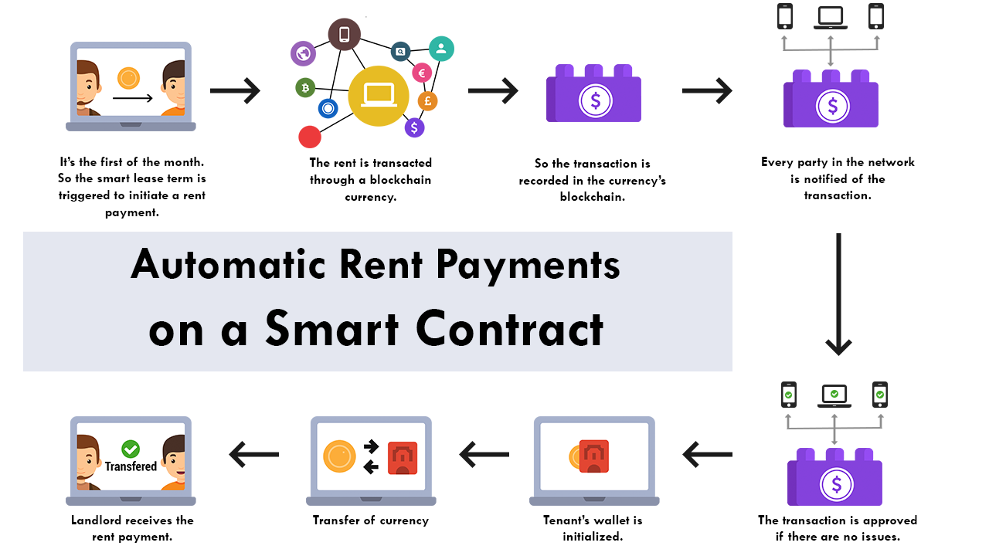
Out-of-court Enforcement
Arbitration
Mediation

Slide 30

Out-of-court Enforcement
At first glance, it may seem that out-of court enforcement is more efficient for the creditor than judicial protection. However, is the same true for the debtor?
While it is true that this approach is based on a contract or agreement between the parties, does this mean that there should be no restrictions, such as those that apply to enforcement proceedings, to protect the debtor?
For example, certain essential items belonging to the debtor, such as his bed, kitchen utensils or washing machine, cannot be attached. Conversely, these restrictions do not apply to smart contracts.

Slide 31
Out-of-court Enforcement
Are we sure that smart contracts should be exempt from safeguards simply because they are based on mutual agreement?
Shouldn't it be essential to check that the parties are not in an unbalanced position and that the terms of the contract were fair, transparent and understood by all parties?

Slide 32
Thank you for your attention!

